Slide 1
COVID-19 Property Pandemic
The Avengers

Slide 2

The Team
Duane Conley
Johnathon Pinson
Shawn Ramrup
Nitu Singh
Angela Silveira

Slide 3
How we chose approached this project:
Multiple ideas identified
Reviewed data available for each idea - some were ruled out as not being viable options
We discussed trying to find something related to video games, housing, Covid-19
Two datasets emerged as being robust & relevant – COVID-19 and home sales

Slide 4


Background & Overview
COVID-19 (SARS-CoV-2) is a novel coronavirus first reported in China in December 2019.
The first confirmed case in the United States was reported January 21, 2020.
WHO issues Global Health Emergency on January 31, 2020 & declares COVID-19 a pandemic on March 11, 2020.
Beginning in March, preventive measures in the US included stay-at-home orders and non-essential business restrictions.
Many larger urban cities experienced surging COVID-19 cases.
This analysis will look to determine how surges in COVID-19 cases in the US have impacted real estate sale price trends in/around urban cities in 2020.
Notes:
Research question: How have surges in COVID-19 cases in the US impacted real estate sale price trends in/around urban cities in 2020?

Slide 5
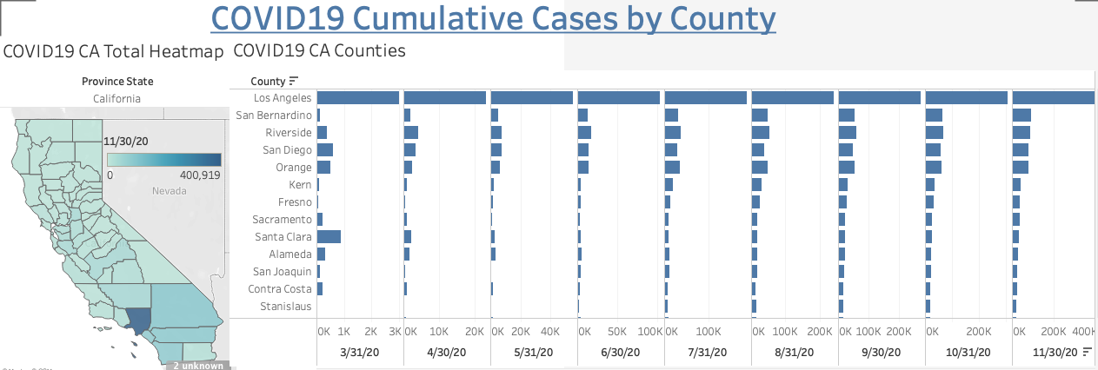

Slide 6
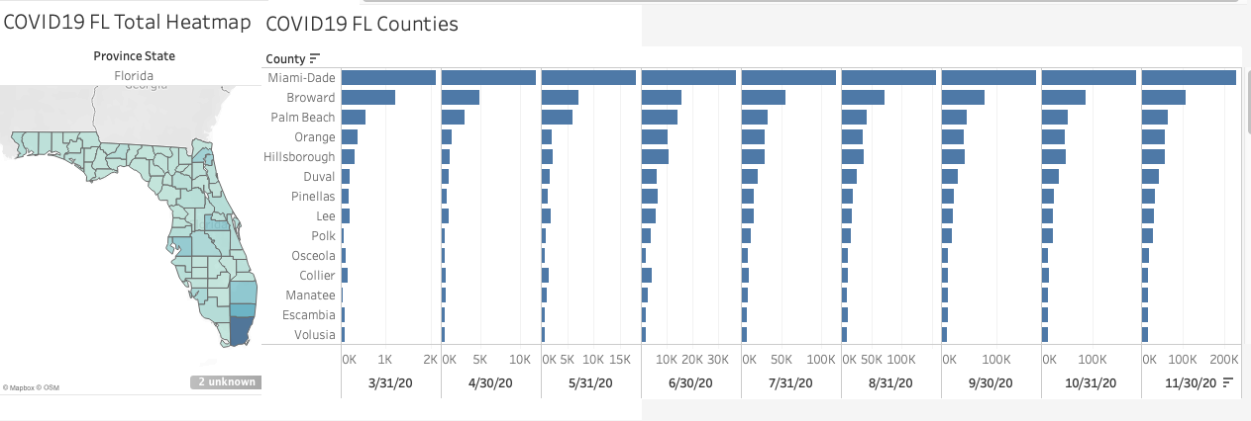

Slide 7
Background & Overview
Our data comes directly from Zillow.com. Home values are determined by the Zillow Home Value Index(ZHVI), “a smoothed, seasonally adjusted measure of the typical home value and market changes across a given region and housing type.”
The Zillow data included all types of homes, condos, rentals and could even be sorted by number of bedrooms.
The dataset had values from 1996 to 11/31/2020.
We wanted to avoid the 2008 recession due to outliers.
We narrowed that down to 2010-2020, and single family residences(SFR).
We chose four cities Los Angeles, Miami, Lakeland, and San Jose..

Slide 8
Background & Overview
Los Angeles
San Jose
Population: 3,979,576 (2019)
Second Largest city in the US.
Closest Ocean: Pacific
Population: 1,021,795 (2019)
Largest city in Northern California
Closest Ocean: Pacific

Slide 9
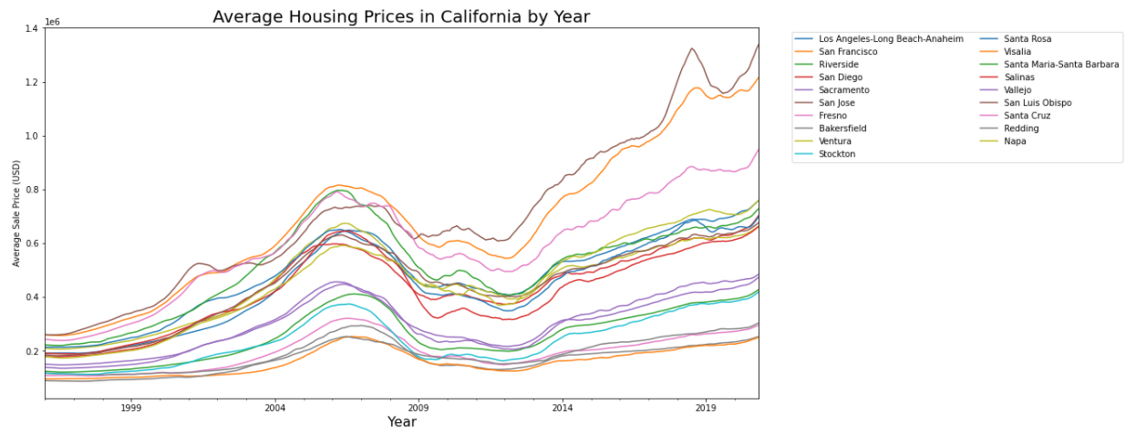

Slide 10
Background & Overview
Miami
Lakeland
Population: 467,963 (2019)
Seventh largest city in the US
Closest Ocean: Atlantic
Population: 112,136 (2019)
Westernmost city in Polk County
Closest Ocean: Atlantic

Slide 11
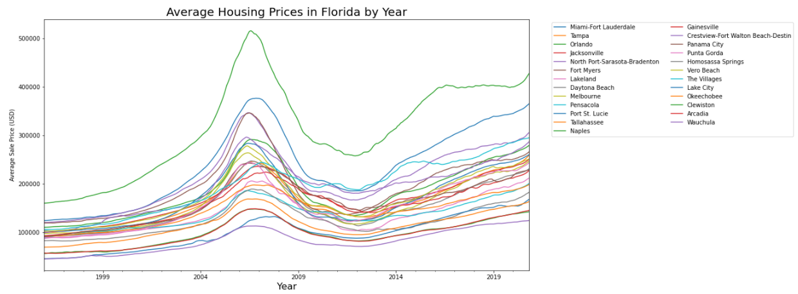

Slide 12
Understanding the data
Real Estate
COVID-19
Zillow dataset
3,000+ datapoints
City/State
Sale Price
Month/Year
2009-2020
John Hopkins University dataset (available on Kaggle.com)
3,000+ datapoints
County/State
Daily confirmed cases
1/22/20-12/7/20

Slide 13
Mission and Goals
The goal of this project is to create a machine learning model to predict housing prices. We also have a secondary goal, we want to see how or if Covid-19 has affected housing prices.
Questions we hope to answer:
Did Covid-19 cause prices to go up or down?
Did the amount of cases in the area affect the prices?
Were there any unusual trends in the data leading up to 2020?

Slide 14
Tools
Pandas - ETL
Database(s) - SQL
Machine Learning
Linear Regression
Tableau/Google Slides - visualizations

Slide 15
Data Preparation
Selection - What kind of data we chose?
Transformation - What did it need to look like?
Database - What was the best database to use?
In-production services
Advanced projects

Slide 16
Machine Learning
We chose to create a Linear Regression machine learning model.
We chose linear regression because its used to predict values within a continuous range, like price.
Predictive Modeling – We are creating two machine learning models.
One model will predict what 2020 prices should have been.
The second model will include the actual 2020 data and examine how it affected the market.
In-production services
Advanced projects

Slide 17
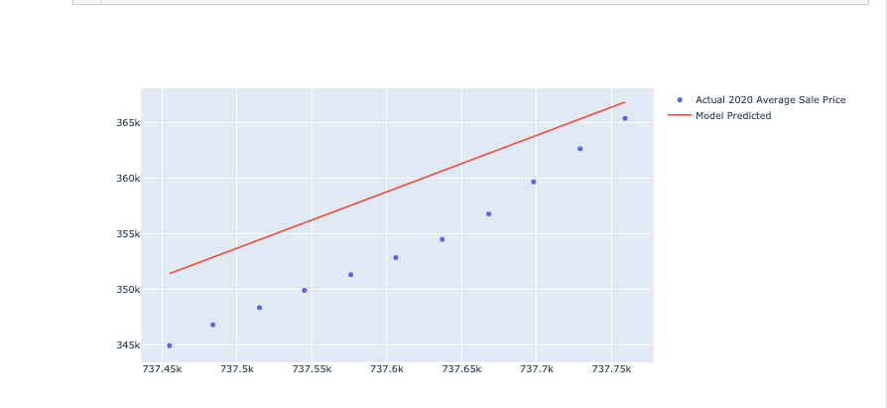
Analysis
2020 ML model vs. 2020 actual
COVID-19 cases (heatmap) with real estate (heatmap)
4
4
5
35
25
22
15

Slide 18
Limitations and Challenges
As we are currently still living thru this pandemic, our Covid-19 and housing data only go to 11/31/2020.
Our data did not include the number of homes sold.
We only had the resources to look at four cities.
In the future we would like to be able to add number of homes sold, when they sold, how long they were on the market, crime rates, and school system ratings to further find out what drives the values of homes.

Slide 19
Summary & Recommendations

Slide 20
Sources
https://www.macrotrends.net/
https://www.Zillow.com
https://www.Kaggle.com

